Slide 1
NORTHWIND DATA ANALYSIS

Slide 2
OVERVIEW
Northwind is a fictional business specializing in a variety of products, including Beverages, Condiments, Confections, Dairy Products, Cereals, Meat, Produce, and Seafood. The dataset includes files such as Categories, Customer Details, Employee Details, Order Details, Orders, and Products. Questions were provided to query the dataset

Slide 3

TOOL USED IS

Slide 4
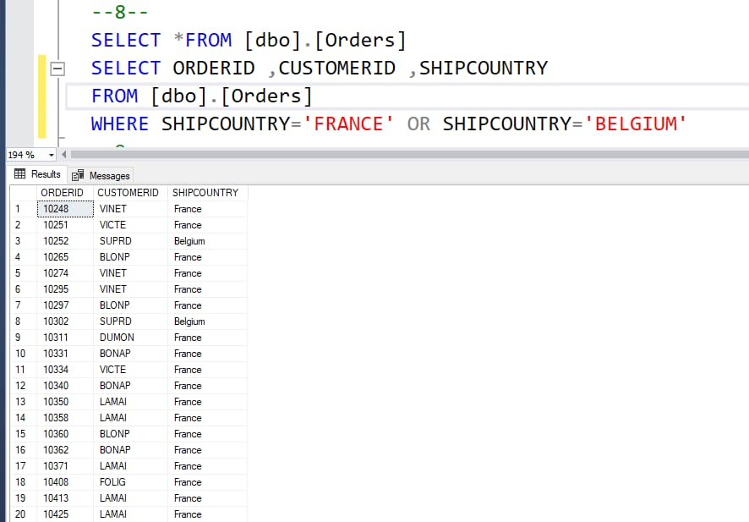
Orders shipping to France or Belgium>

Slide 5
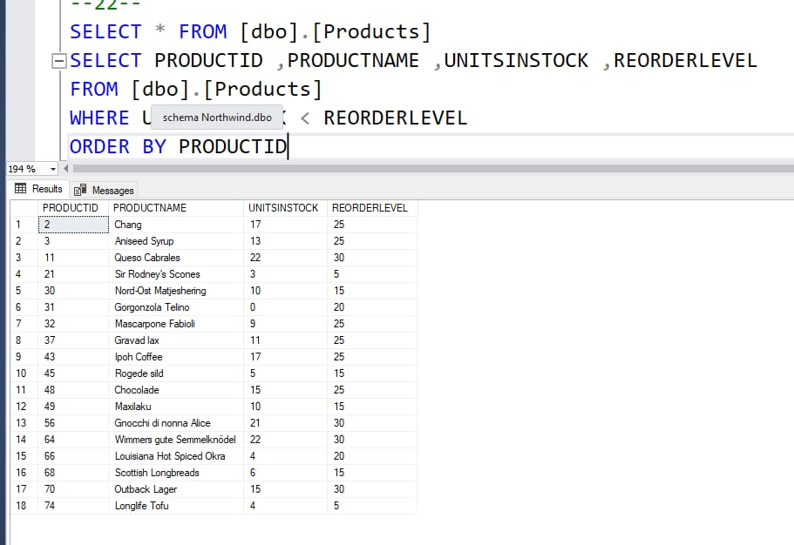
Products that need reordering>

Slide 6
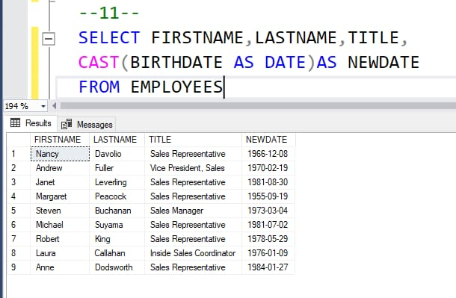
showing the Employees in order of Birth-Date, we see the time of the Birth-Date field, which we don’t want. Show only the date portion of the Birth-Date field.

Slide 7
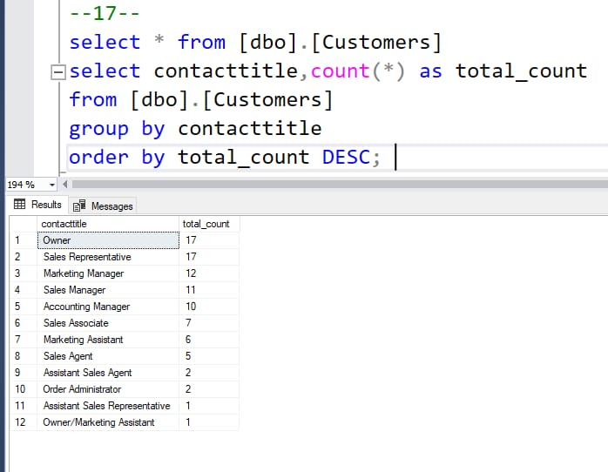
Show a list of all the different values in the Customers table for Contact-Titles. Also include a count for each Contact-Title.

Slide 8
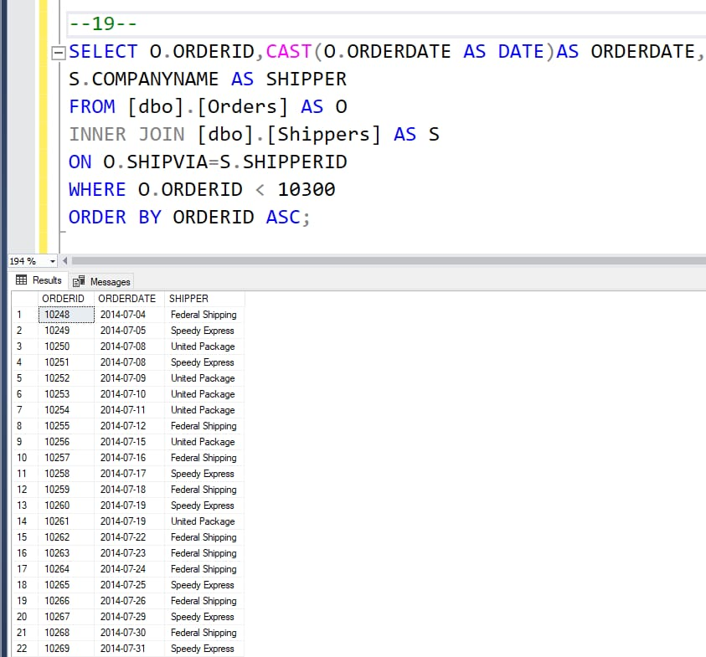
how the Order-ID , Order-Date (date only), and Company-Name of the Shipper, and sort by Order-ID.

Slide 9
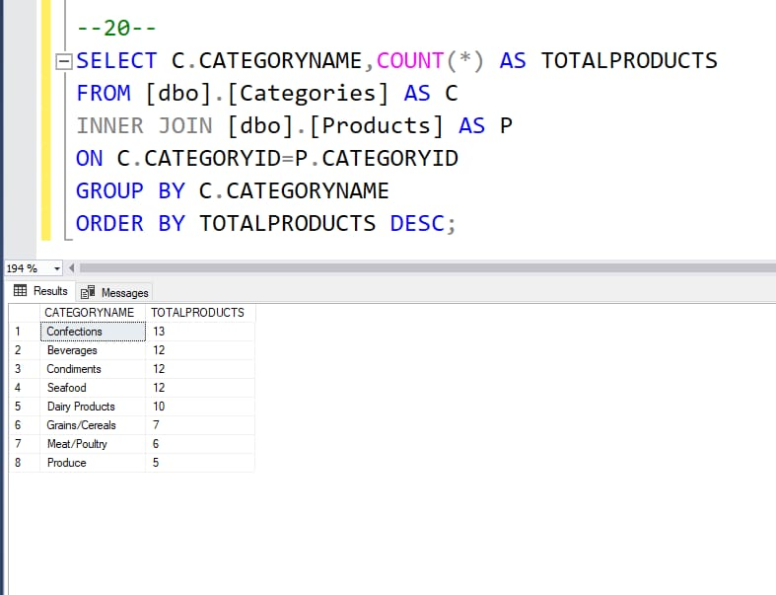
the total number of products in each category. Sort the results by the total number of products, in descending order.

Slide 10
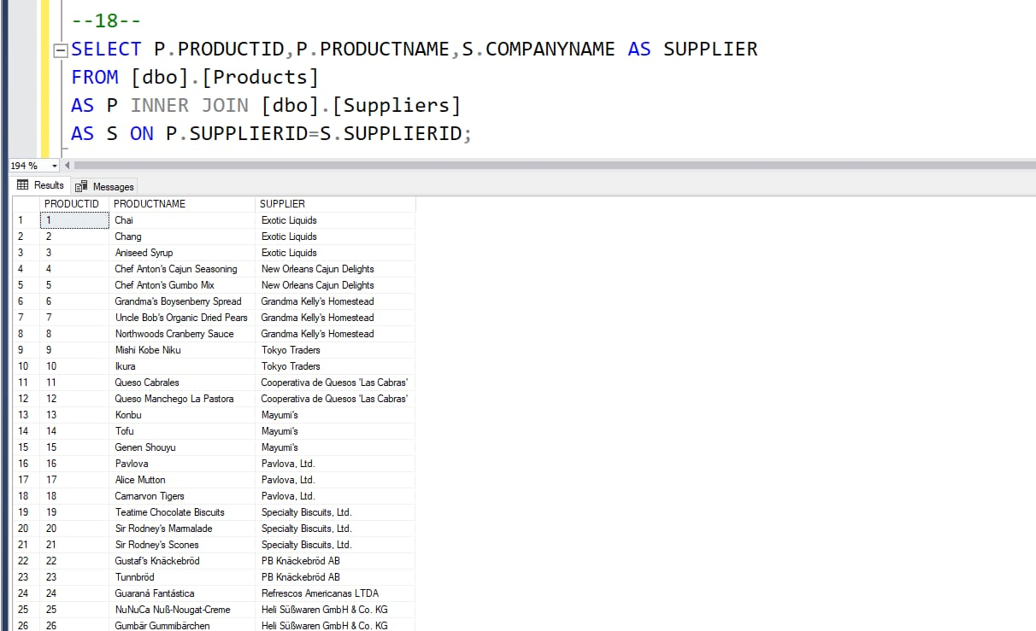
For each product, the associated Supplier. Show the Product-ID, ProductName, and the Company-Name of the Supplier. Sort by Product-ID.
This question will introduce what may be a new concept, the J

Slide 11
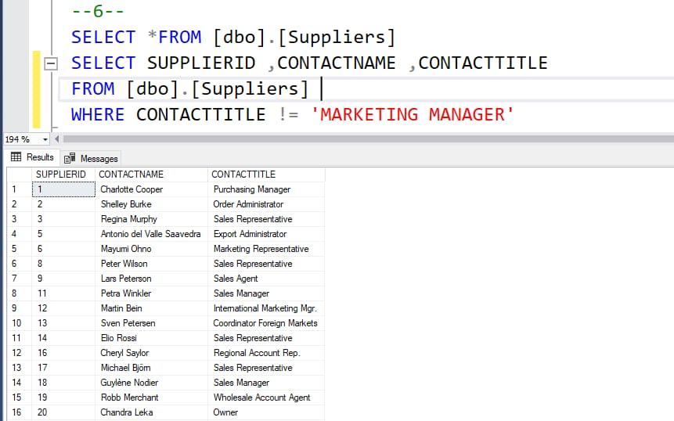
In the Suppliers table, show the Supplier-ID , Contact-Name , and Contact-Title for those Suppliers whose Contact-Title is not Marketing Manager

Slide 12
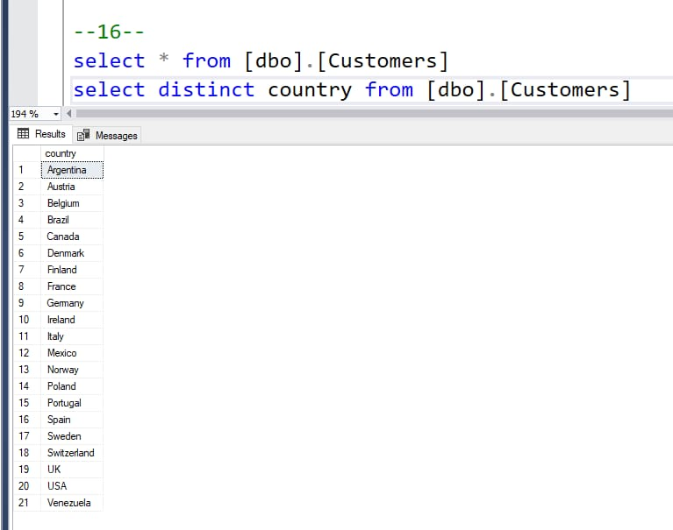
Countries where there are customers

Slide 13
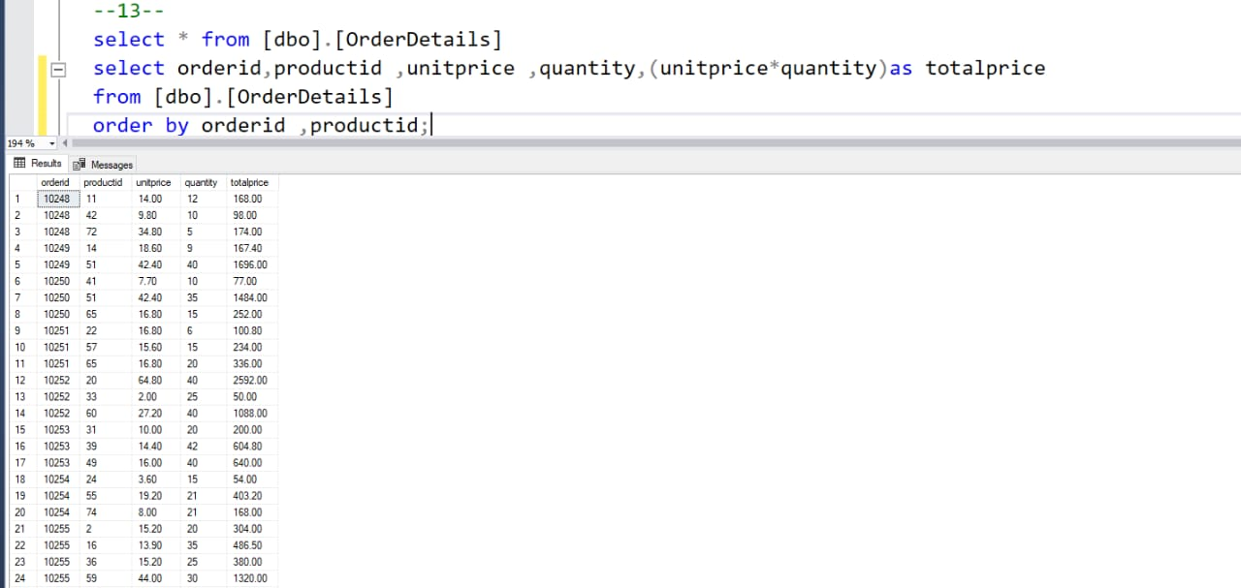
Create a new field, Total-Price, that multiplies these two together.

Slide 14
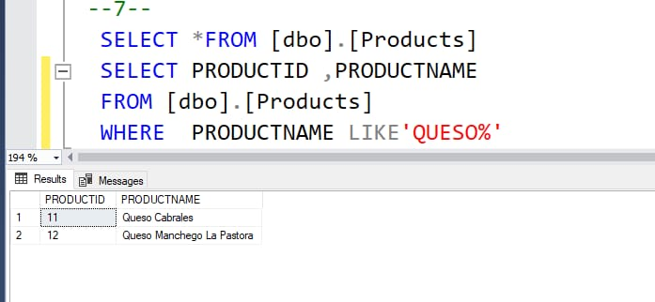
The Product-ID and ProductName for those products where the ProductName includes the string “queso”.

Slide 15
THANK YOU
Prepared by AZRA

